Slide 1


Data Structures
Tourism & Travel Management System
Group Members
Member 01: Ali Hassan (Group Lead)
Member 02: Ayesha Saleh
Member 03: Malika Salam
Member 04: Wania Adnan
Date: Dec,29,2025
Total Slides: 17
Department of Creative Technology - FCAI
1

Slide 2

Introduction
The Tourism & Travel Management System is a web-based application designed to simplify the process of tourism planning and management.
It allows users to explore travel destinations, view tour packages, and
make bookings online.
The system also provides an admin panel to efficiently manage tours,
users, and bookings.
Department of Creative Technology - FCAI
2

Slide 3
Problem Statement
Traditional tourism management systems face several challenges:
  Lack of centralized tour information.
  Time-consuming customer handling.
  Limited accessibility for users.
These issues create inefficiency for both customers and travel
administrators.
Department of Creative Technology - FCAI
3

Slide 4
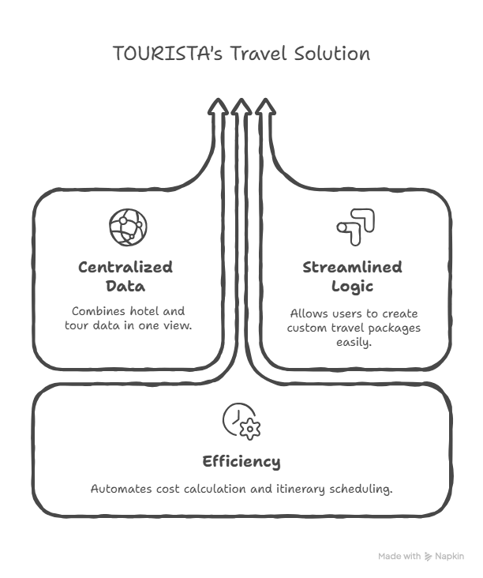
Tourista’s Travel Solution
Department of Creative Technology - FCAI
4

Slide 5
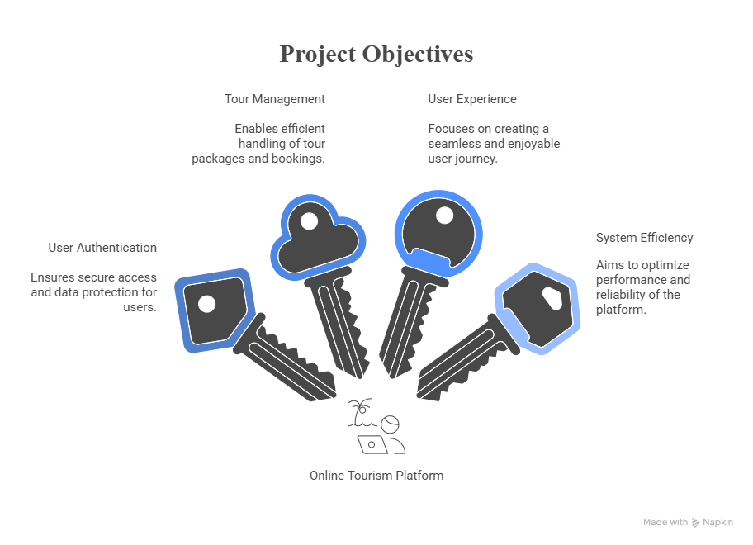

Project Objectives
Department of Creative Technology - FCAI
5

Slide 6
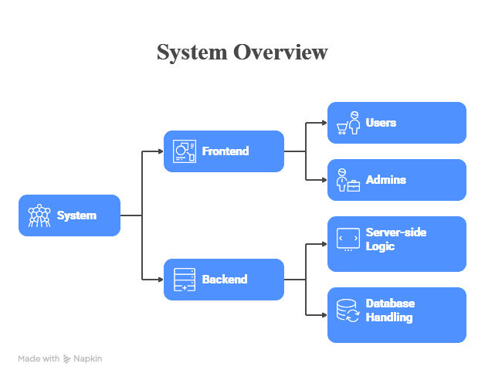
System Overview
Department of Creative Technology - FCAI
6

Slide 7
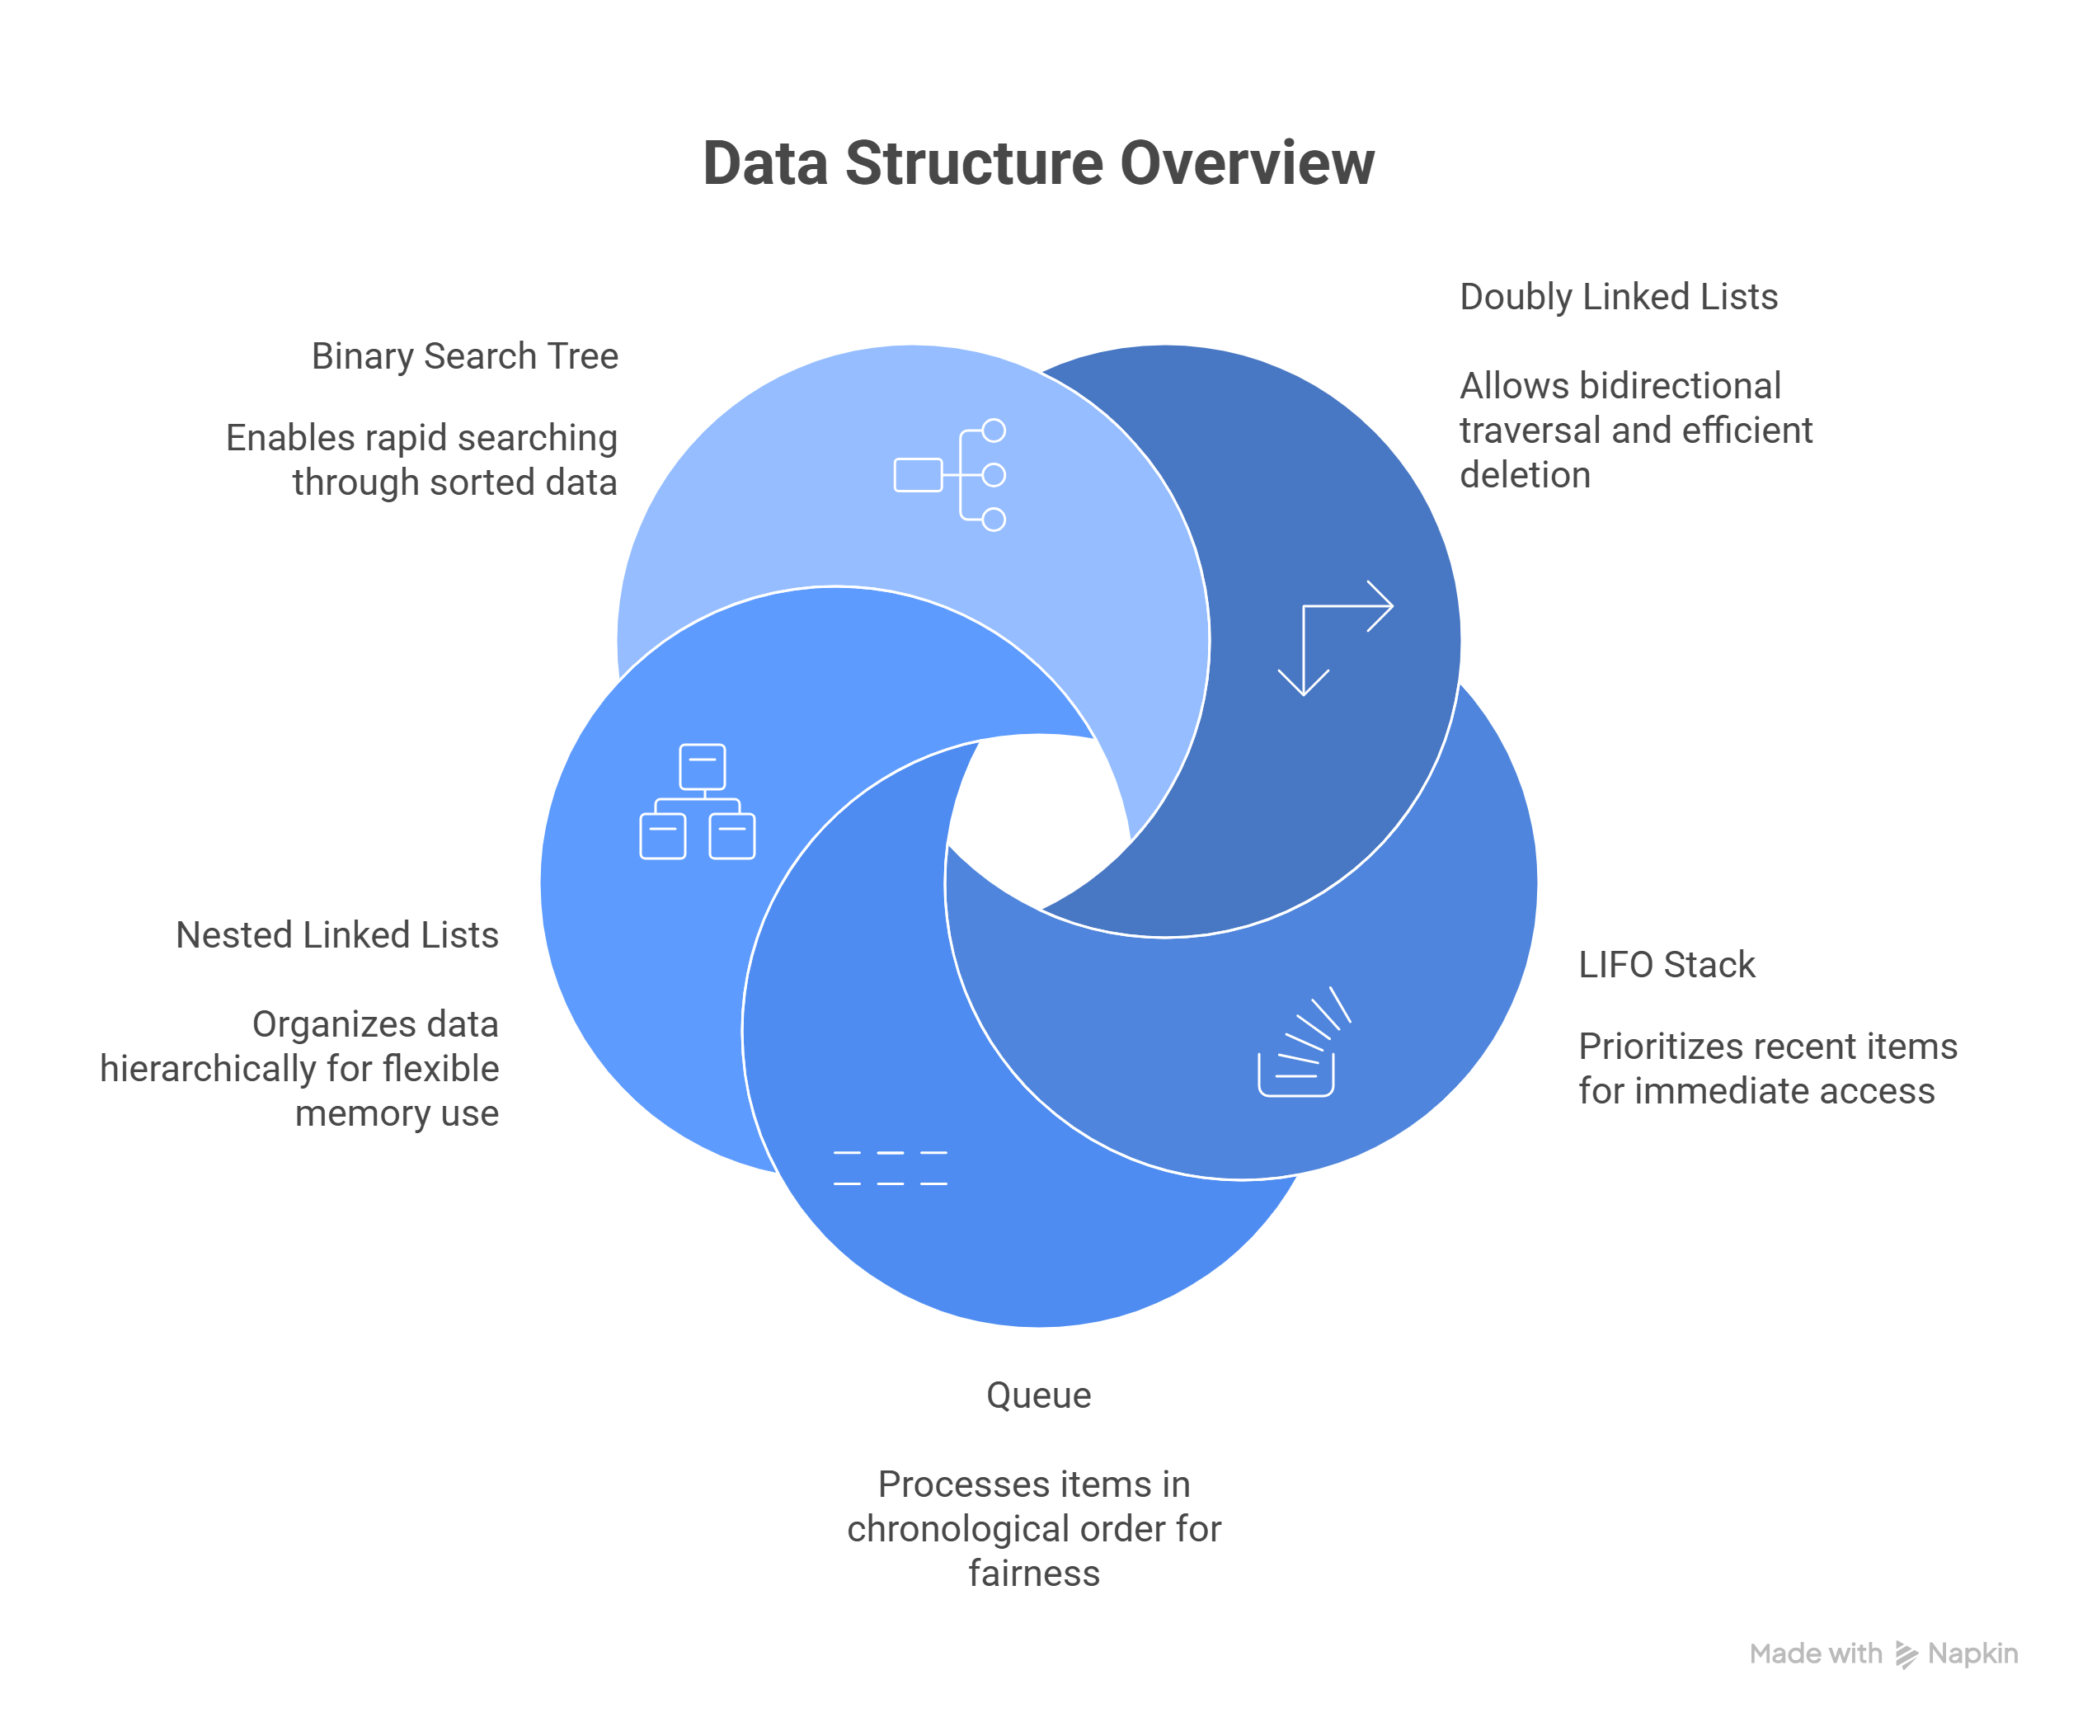
Methodology
Department of Creative Technology - FCAI
6

Slide 8
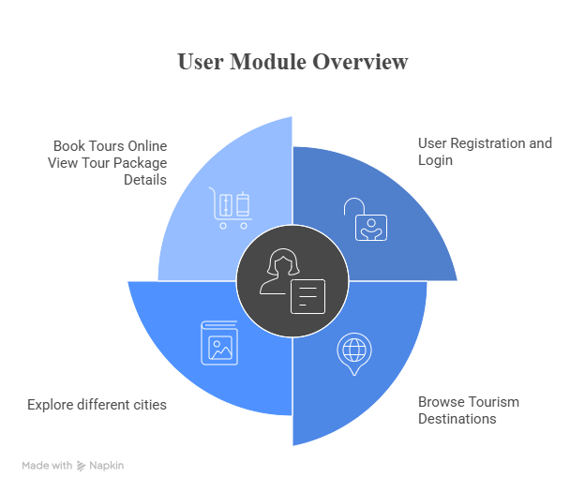
Features
Department of Creative Technology - FCAI
7

Slide 9
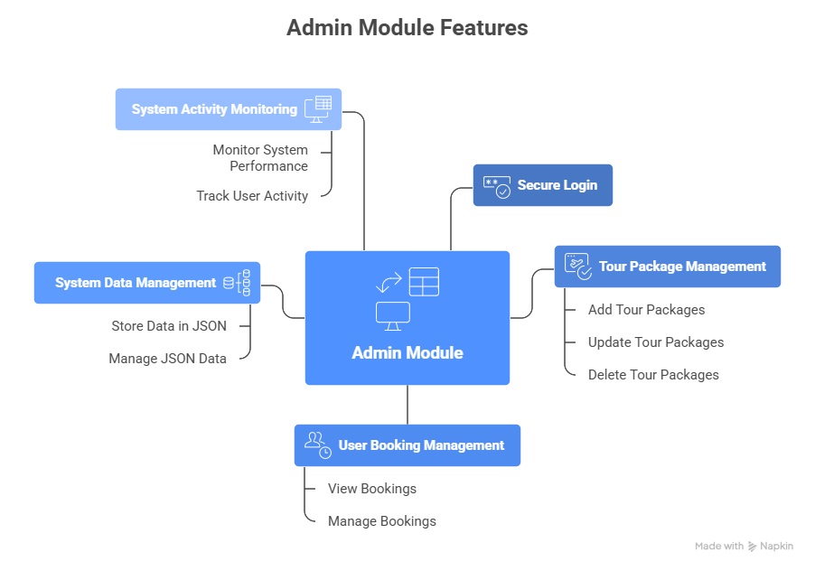
Features
Department of Creative Technology - FCAI
8

Slide 10

Frontend
The landing page provides user-friendly interface for users to explore tourism services.
Department of Creative Technology - FCAI
9

Slide 11
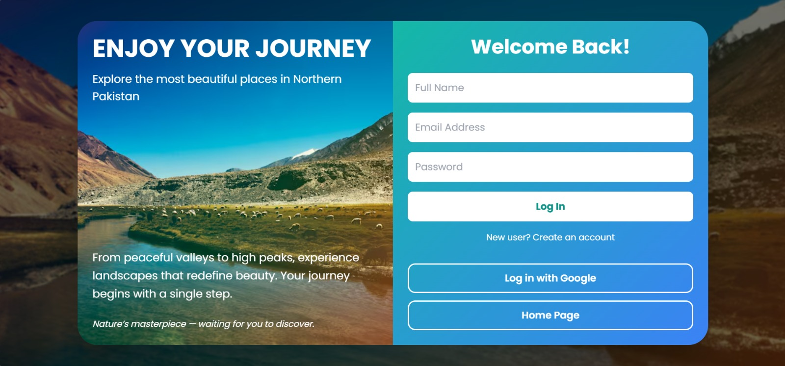
Frontend
This page allows users to securely register and log in with email/google account.
Department of Creative Technology - FCAI
10

Slide 12
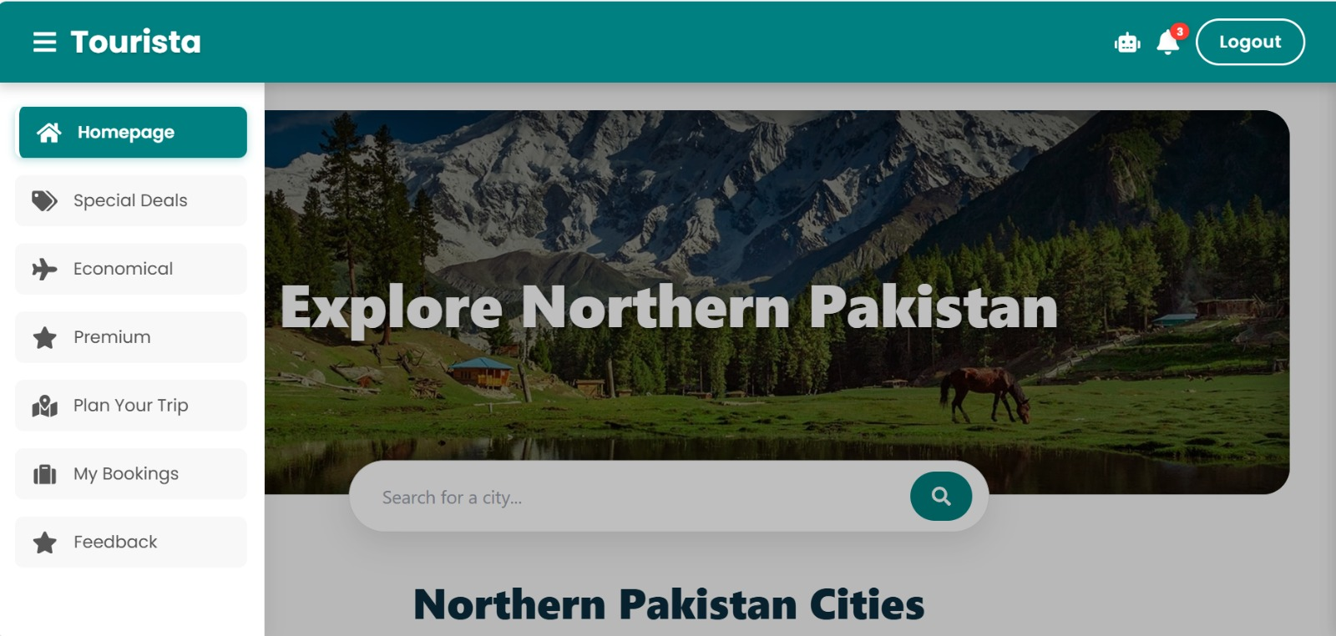
Frontend (User’s Dashboard)
Users can browse available tour packages and view destination details.
Department of Creative Technology - FCAI
11

Slide 13
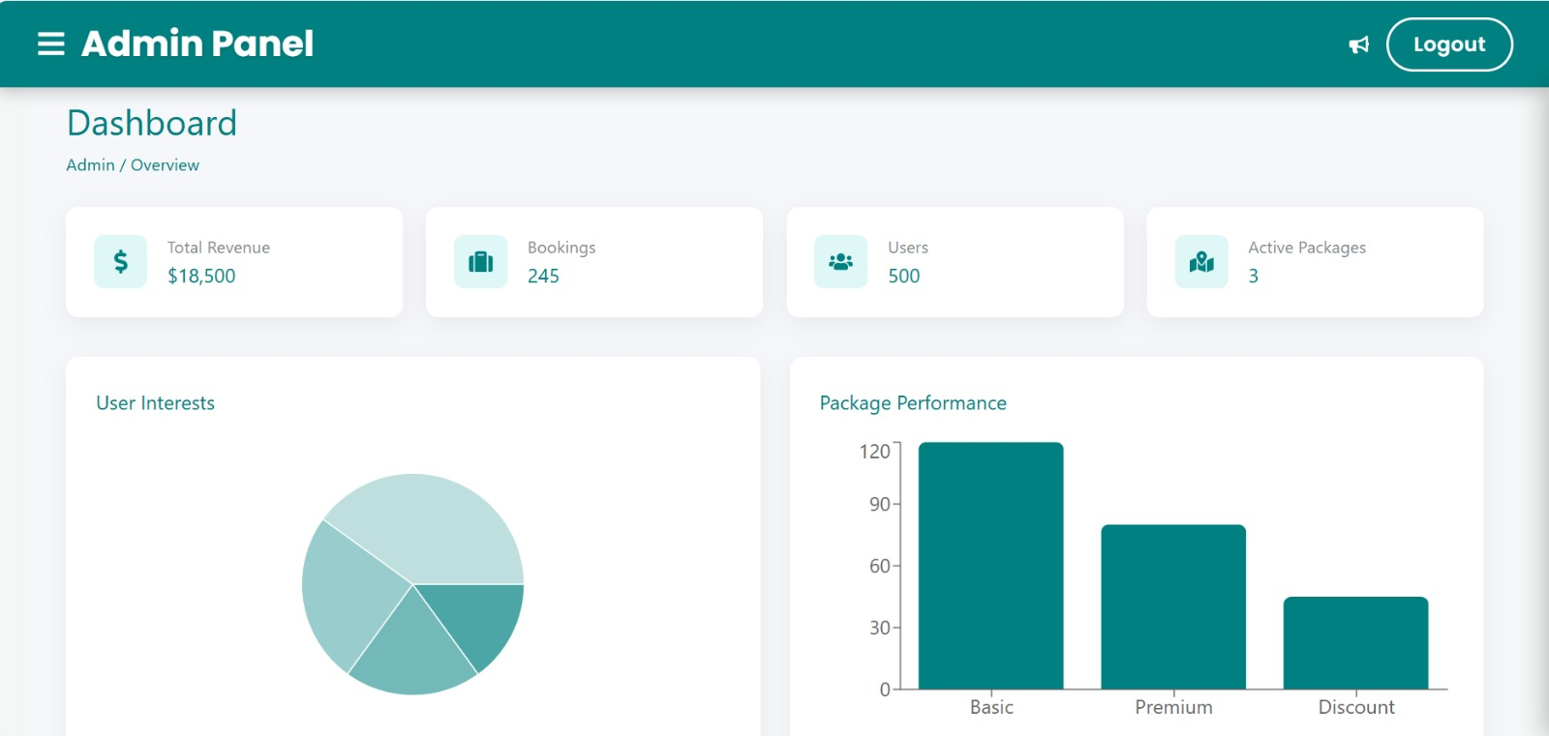
Frontend (Admin’s Dashboard)
The admin dashboard manages tour packages and system data.
Department of Creative Technology - FCAI
12

Slide 14
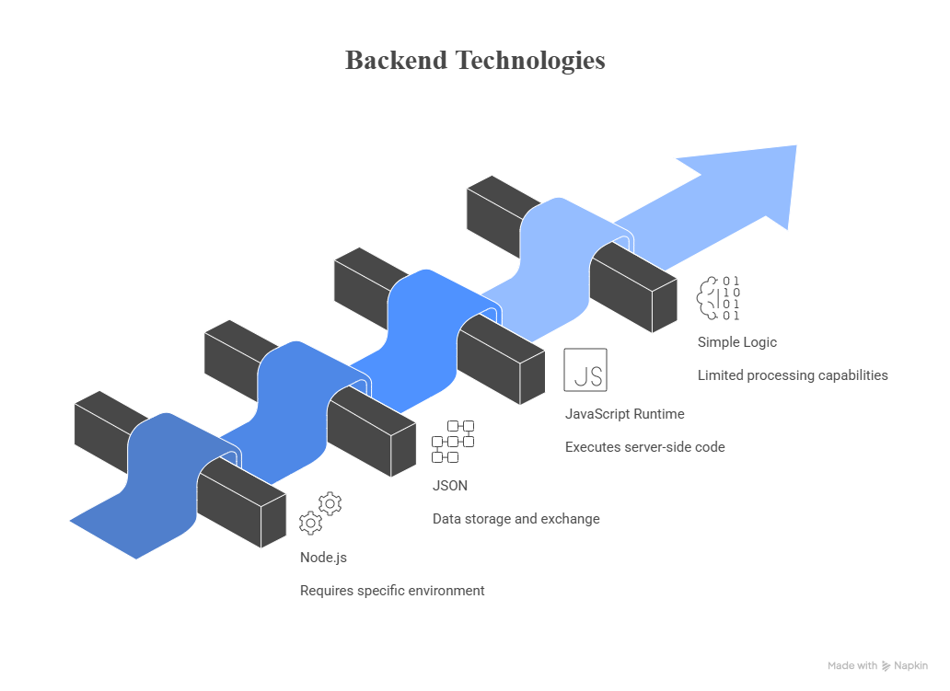
Backend Technologies
.
Department of Creative Technology - FCAI
13

Slide 15
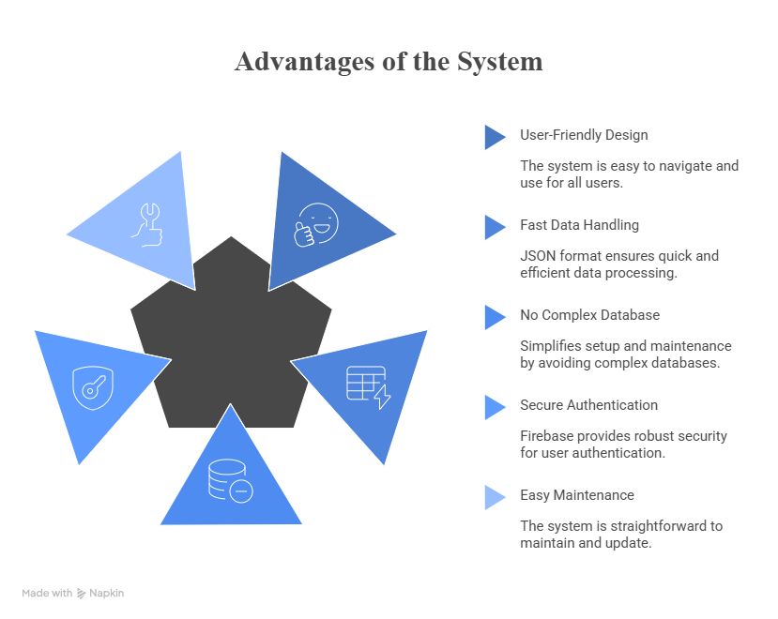
Advantages of the System
Department of Creative Technology - FCAI
14

Slide 16
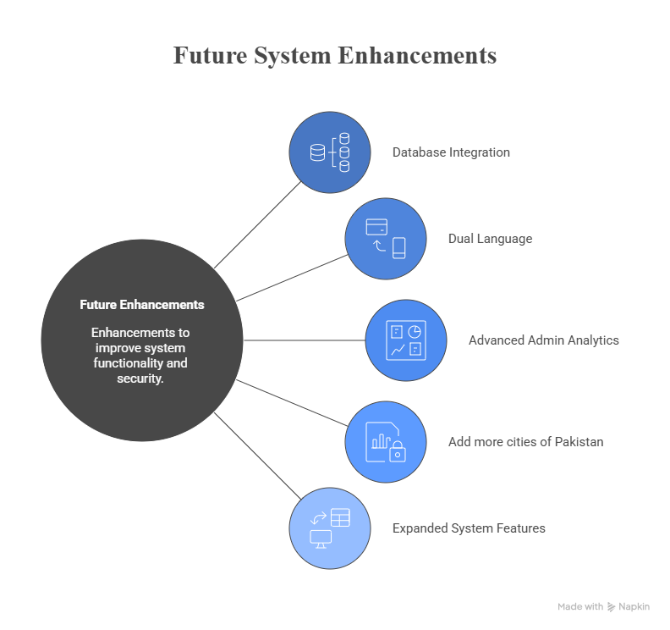
Future System Enhancements
Department of Creative Technology - FCAI
15

Slide 17
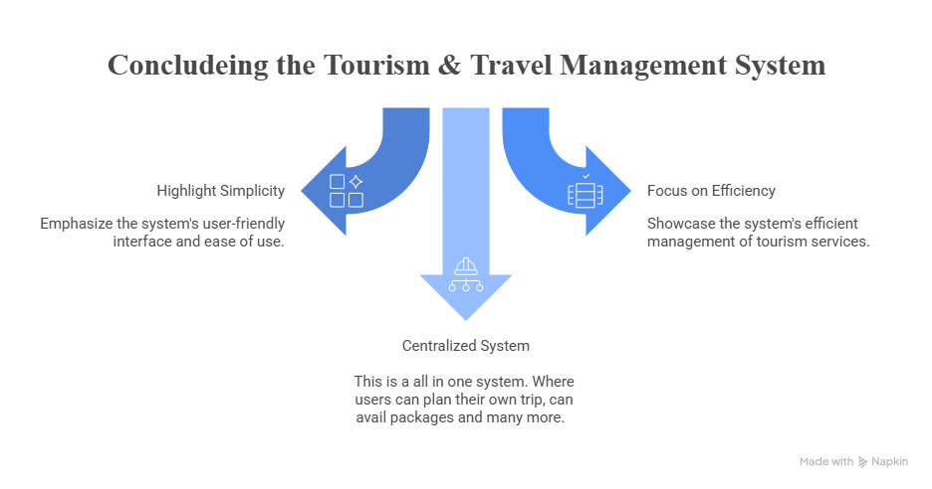
Conclusion
Department of Creative Technology - FCAI
16

Slide 18

Department of Creative Technology - FCAI
17

